Slide 1

NATIONAL JUDICIALACADEMY
7th to 9th August, 2015
Conference
on
Judicial Administration

Slide 2
E-courts Project
How to use it for
Data Management and
Analysis
Presented by
Justice S G Shah
B. Sc. (Micro) LL. M.
Judge,
HIGH COURT OF GUJARAT

Slide 3

The competitor may be litigants - accused or member of the bar - may be well equipped & well trained, we must able to cope up with their standard to find out the truth from evidence with help of technology

Slide 4


Slide 5


Slide 6


Slide 7


Slide 8
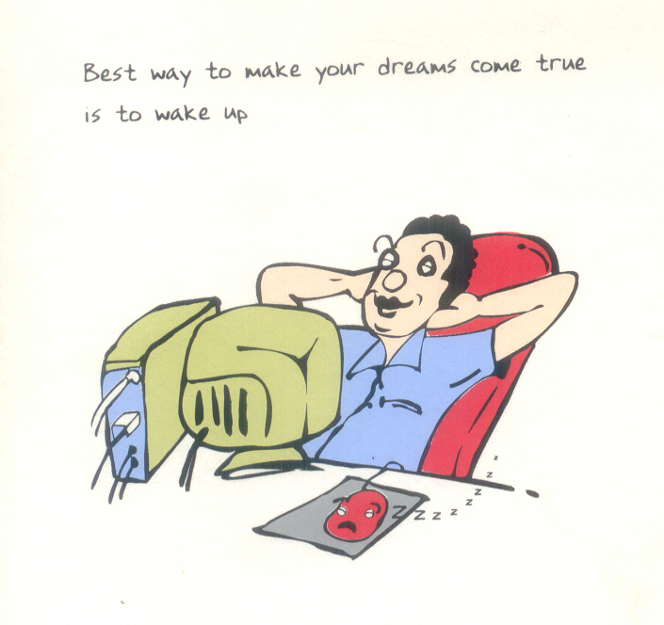

Slide 9
Basic Facts about Computers and Computing
A computer is a machine or tool, which is capable of: a. Taking input data. b. Storing the input data. c. Processing the input data. d. Producing the output reports on paper or electronic storage devices for utilization at any time in future and at any place.

Slide 10
Importance of Computer: a. Collecting data. b. Storing data. c. Processing data. d. Retrieving data. e. Using data to:
(1)plan
(2)monitor operations
(3)control operations

Slide 11
The two forces that drive a computer to carry out a task are:
(a) Electrical Energy.
(b) Human Energy.

Slide 12
The electrical energy is activated by the human energy. A human drives a computer to carry out a task by issuing some instructions or commands for the computer to obey. The instructions or commands are expressed in a language which the computer understands. There are many features of computing / processing the data through computer and each has its own unique features.

Slide 13
If we issue wise instructions, the computer will carry out the task wisely. If we issue foolish instructions, the computer will carry out the task foolishly.
Thus, it is a common saying in the computer world that:
GARBAGE IN, GABAGE OUT (GIGO)
We can, therefore, say that the intelligent performance of a computer is directly proportional to the intelligence of the instructions that drives it.

Slide 14
Data & Information
Data = Information Entered / Kept Saved, Retrieval in same format, Some thing intangible – which can be operated i.e. Processed
Processed Data = data + skill

Slide 15
Present Judiciary
  To make the judicial administration healthy, one has to consider:
  What is lacking in judicial administration?
    Delay:
        Lack of knowledge?
        Wastage of judicial time.
    Irregularity:
        Lack of interest in technology?
        Lack of skilled man power?
Objectives
What public demands from Judiciary?
  Decongestion of disputes by speedy disposal

Slide 16
Revolution
Potter’s Wheel Printing Press
Steam Engine Electricity .
Microchip
Computer & Internet
World/War
Physical Cyber
Bricks & Mortars Bits & Clicks
Cyber Space

Slide 17
What is the need of the day?
  Learning Information & Communication Technology, to pick up the speed with the growing technology in 21st century when Computer & its usage with Internet has changed the limitation of territorial boundaries for every one within no time.

Slide 18
Information is the key of successes
Technology will Marshal the information from knowledge to result in to the successes in the form of:
  Case Management
  Court Management
  Information Management
  Knowledge Management
  Play with Information
  Information Packages
  Appropriate software
  Legal databases
  Quicker Action to process information

Slide 19
Traditionally, judiciary is a
conservative institution;
therefore, it is not surprising as to why the judiciary is slow in reacting to changes in technology;
moderating and directing while maintaining a balance between competing claims is now certainly in the interest of rule of law.

Slide 20
However, having realized
the tremendous potential of ICT
to improve
Access, Equality & Accountability,
the Indian Judiciary today is in a hurry
to adopt technology in
Judicial Administration
where changes are immediately possible
to make the system litigant friendly.

Slide 21
It is a continuing process in which INNOVATION, EXPERIMENTATION & ADAPTATION
have infinite possibilities
provided the mind – set is changed and judges & administrators become technology savvy. Managing the transition efficiently is crucial.

Slide 22
Establishment of Laws and bringing practices in conformity thereto is necessarily a long drawn process.

Slide 23
Law, by itself, may not be enough.
Law is only an instrument.
It must be effectively used.
This effective use depends as much on a supportive judiciary as on the social will to change.

Slide 24
Active technological reform movement,
if accompanied by
properly enforced legal reform
can transform the society.
Effective technological reform movement
does need the help of law and
a sympathetic judiciary to achieve its objectives.

Slide 25
Independent, effective & efficient judicial system is must in a modern administrative system.
Modernization, Streamlining and Improved Efficiency in Court Systems are paramount in increasing Citizens’ faith and confidence in Judicial System and State.

Slide 26
Objectives of ICT in Courts
To help the Judicial Administration in streamlining its day-to-day activities
To provide web based information & inquiry counter for the benefit of litigants
To provide transparency in judicial & administrative decisions as well as of information
To cut short delays in all applications
To comply with RTI Requirements

Slide 27
E-governance is the key word in every department of life.
It increases productivity,
enhances transparency & accountability
and reduces red tapism & corruption
in administration.

Slide 28
More than 8000 Courts have secured their presence on the e-Courts National portal (ecourts.gov.in) which provides cause-list, case status information in respect of more than 2.5 crore cases (pending & decided) and has sometimes reached daily ‘hits’ in excess of 7 lakhs which is growing exponentially every week.

Slide 29
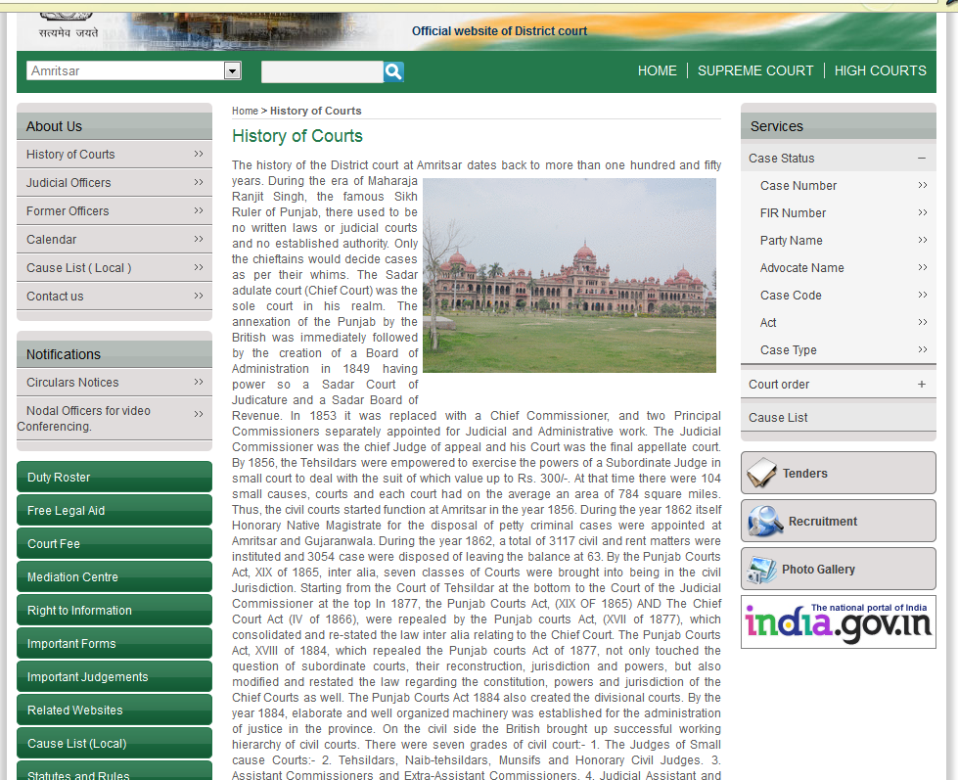
SERVICES

Slide 30
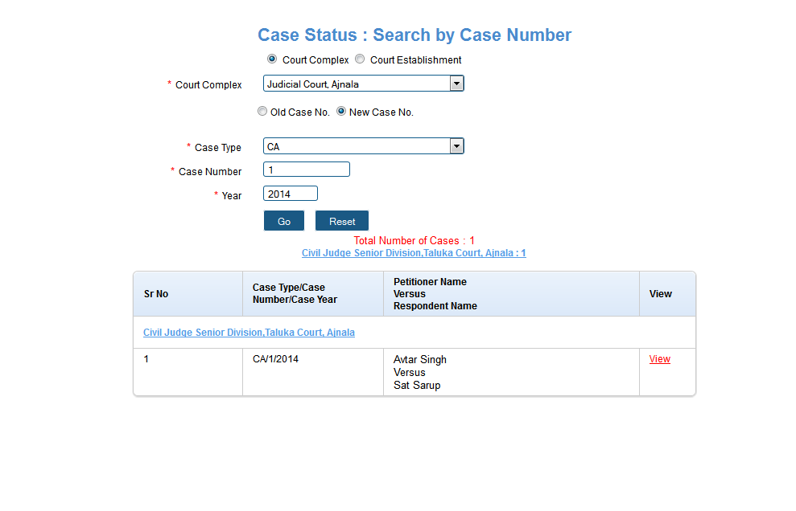
SERVICES

Slide 31
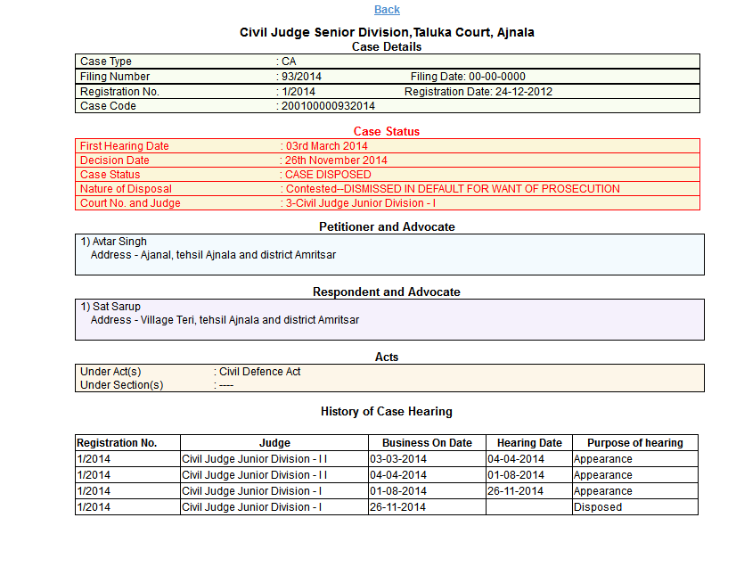
SERVICES

Slide 32
The e-Courts National portal
of the e-Courts project showcases the
National Judicial Data Grid
which also provides training material for Judicial Officers and staff and general information to the public and will eventually be a very powerful mode of communicating all aspects of judicial reforms.

Slide 33
Unified National Core CIS version 1.0 of the Case Information Software has been developed. This is in use in almost all States. The process of migration of old data & Data entry of pending cases into it is in progress and has reached an advanced stage of completion. Entry of case data is complete in some States, while adequate progress has been made in other States. On completion of data entry, every litigant can access information about his/her case from the e-Courts National portal.

Slide 34
GOAL POSTS TO REACH
An analysis of the conceptualization, planning and strategy of the first phase of the Project suggests that there are some more goal posts to cross.
Delivery of all the services by all the Courts,
Optimum automation of case workflow,
    use of computers by all important sections of Registry for day to day processes and service delivery,
Unified CIS for all Courts,

Slide 35
      Timely and regular updation of data on NJDG by all Courts,
      Discontinuation of Manual Registers,
      Ideal Central Filing Center with sufficient infrastructure,
      Judicial Performance Assessment through ICT,
      Scanning and Digitization of the Case Records,
      Court Record Room Management & Automation,

Slide 36
Court Libraries Computerization,
Video Conferencing for all Courts with Jails,
Legal Aid Offices (DLSA/TLSC) ICT enablement,
WAN (Wide Area Network) connectivity for all Courts,
Solar energy for power backup,
Mobile based service delivery through SMS & Mobile Appsetc. are just a few of the many important objectives.

Slide 37
Most of the deficiency in uploading of data onto NJDG and therefore the lack of delivery of services online is attributed to issues relating to lack of effective, stable and reliable WAN connectivity for the Courts.

Slide 38
The hardware & software has only been sufficient to use CIS for data entry, case updation, order / judgment writing and cause list generation. The Courts have not been able to fully shift to automated processes.
The Phase II of the Project will adopt the Cloud Computing Architecture for all application and database requirements for the Courts. Under the
Cloud Computing Environment, applications and databases used by the Courts will be hosted in Cloud Environment facilitated at State Data Centers (SDCs).

Slide 39
The cloud computing environment offers unique and valuable benefits for an eGovernance Project including the reduction in server infrastructure cost, centralized / federated application management, efficient server and resources management, automated scalability of application / database servers, etc.

Slide 40
Shifting to Cloud Environment will also call for a seamless, stable, reliable and secure connectivity from all Court Complexes in the country up to the State Data Centers located in the respective States. As the Court Clouds will primarily be at State Data Centers, a full fledged Disaster Recovery Mechanism will have to be put in place for all Court Clouds at National Data Centre.

Slide 41
As Cloud Computing Environment is being adopted for implementation in phase II of the Project, new Court Complexes will not require any server infrastructure as all application and database hosting needs will be catered to by Cloud Model only. All data, including meta data (that is the data about the data) will be unified and standardized in this phase.

Slide 42
For software solutions in the eCourts Project across the country, the eCommittee will be the nodal agency for policy on software solutions to be used on the hardware provisioned through the eCourts Project. This uniformity will ensure compatibility also in the initiatives going on at national level like National Judicial Data Grid (NJDG) and integration of various stakeholders of the Justice Delivery System.

Slide 43
In order to achieve a seamless compatibility of application and data of CIS across all Courts of the country, the CIS should be horizontally and vertically integrated. By horizontal integration, the CIS of one Court will be able to export to or import from the case-data of other Courts. Fresh data entry of the case will not be required and the system will be able to effect the transfer with all the case history details.

Slide 44
By vertical integration, the CIS of the Courts of different hierarchy will be able to transmit data to and from each other.
An attempt will be made to enable uniformity in data structures with local variances so that horizontal and vertical integration can be made possible.
This will require standardization of data structures, meta data (that is the data about the data) etc. across the CIS at all levels of the Courts.

Slide 45
The Retrieval of digitized data will be ensured by porting the soft copies of the data into Data Management System.
The main challenge in the way of regular and uninterrupted long term use of the soft copies of the digitized data; that is archival and preservation; is the frequent obsolescence of technology.

Slide 46
It is also necessary that process automation solutions should be integrated with each other as much as possible and feasible so that it does not duplicate the efforts relating to certain data sets or applications common amongst those applications.

Slide 47
The National Judicial Data Grid (NJDG) will be strengthened to mine data of all cases, decided or pending.
This will enable policy planners and policy makers to manage case loads and bring in effective case management systems.

Slide 48
A comprehensive software mechanism in the form of Legal Database has to be in place which has the repositories of all the Supreme Court and High Court judgments and also keeps track of new judgments affecting the earlier judgments.
This software also needs to have a mechanism for porting metadata of the judgment onto it, which also includes Head Notes of the judgments.

Slide 49
This software will have to be developed on FOSS - Free and Open Source Software - technologies and will have mechanism for the High Courts to port their judgments with meta data and the head notes.
This will eventually become the Official In-house Case Law eJournal of Indian Judiciary.

Slide 50
National Judicial Data Grid (NJDG) is intended to be the National Data Warehouse for case data including the orders / judgments for Courts across the country.
Phase II of the Project will aim at attaining the full coverage of case data of Courts across the Country.

Slide 51
The uploading mechanism in Phase II will gradually shift to auto pull mechanism from State court cloud installations which will ensure smooth updation of data on NJDG.
Storing the data without the data analysis tools will be futile exercise.

Slide 52
TOOLS OF DATA ANALYSIS

Slide 53
Data Warehousing
Data warehousing is the process of extracting and storing data to allow easier reporting. The process of Data warehousing will help in more efficient centralization or aggregation of data from multiple sources into one common repository. Data warehousing techniques will allow the possibility of various dynamic and comprehensive reports from the data made available on NJDG portal.

Slide 54
Present functionality of NJDG provides for
reports of undated (non-updated) cases in the system which needs to be further improved to be converted to auto alerts through email and NJDG dashboard.
Graphical Charts for reports of NJDG.
Judicial Performance Assessment Mechanism through NJDG.

Slide 55
object
The access mechanism provided on ecourts.gov.in under NJDG (National Judicial Data Grid) may be useful to study the kind of reports generated from the data uploaded by Court Complexes across the country.

Slide 56
This reports are accessible presently only in NICNet network at: http://10.248.118.147/njdg_public/
The data available through this link only of those Court Complexes where CIS data migration has been completed to National Core version.

Slide 57
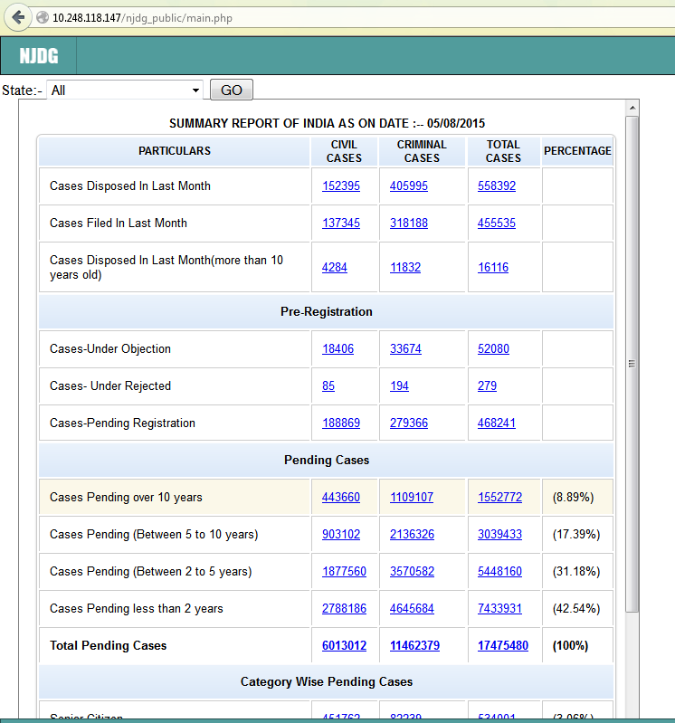
NATIONAL DASH BOARD

Slide 58
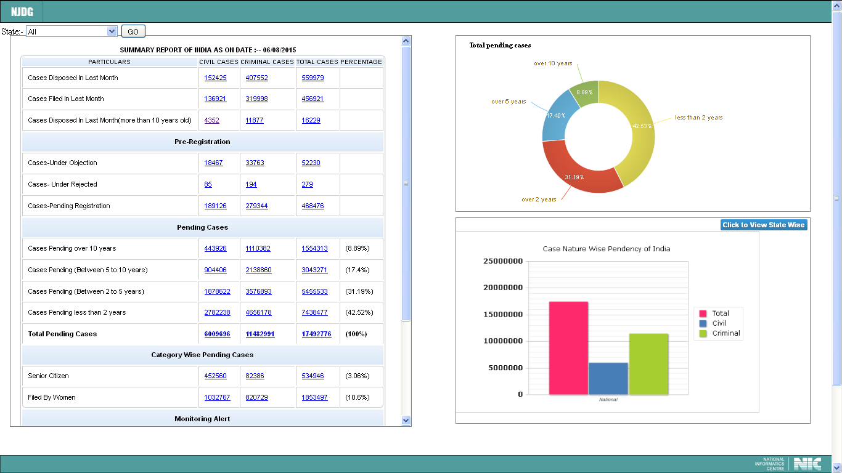
NATIONAL DASH BOARD

Slide 59
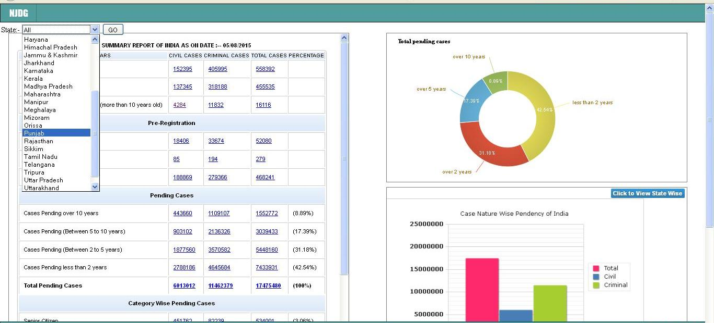
STATE WISE DASH BOARD
Select State from drop down and click Go

Slide 60
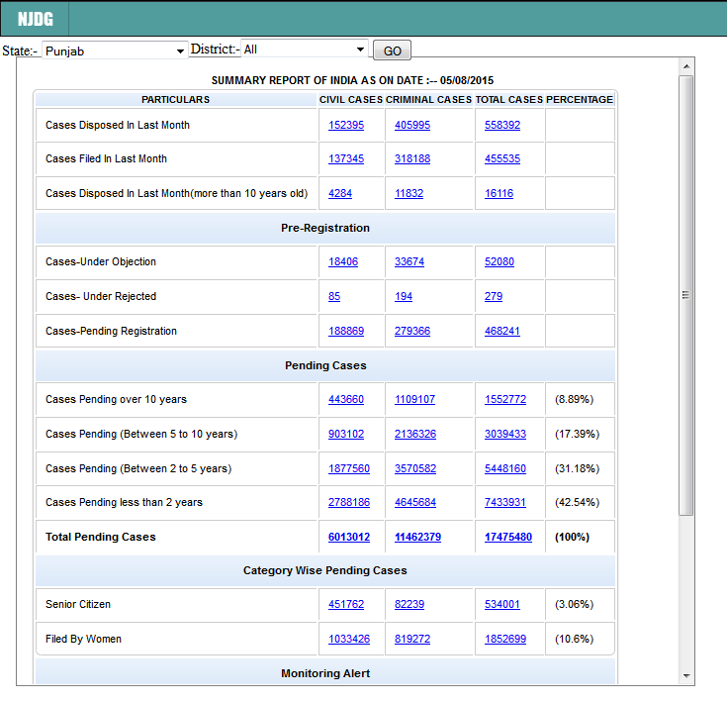
STATE WISE DASH BOARD

Slide 61
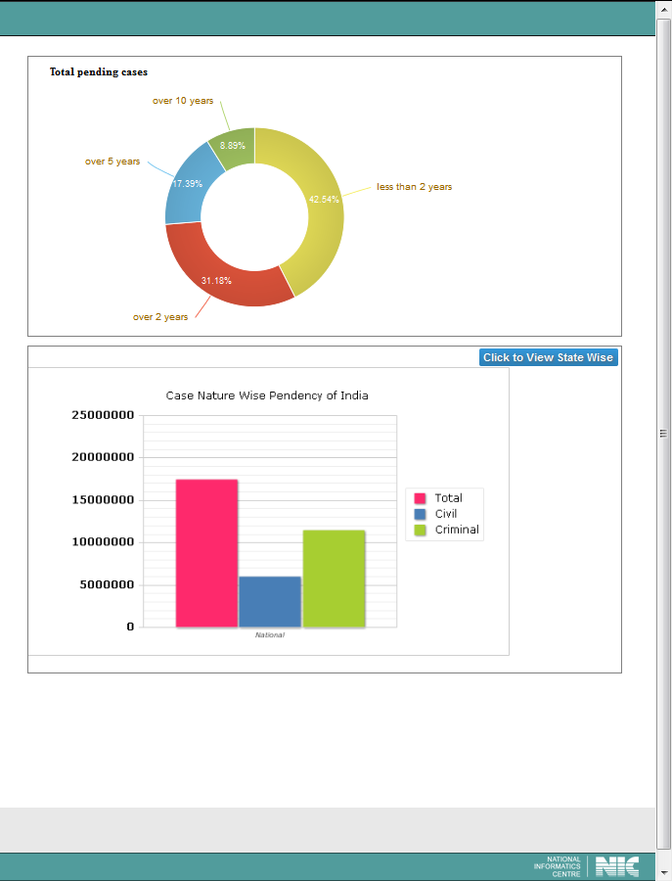
STATE WISE DASH BOARD

Slide 62
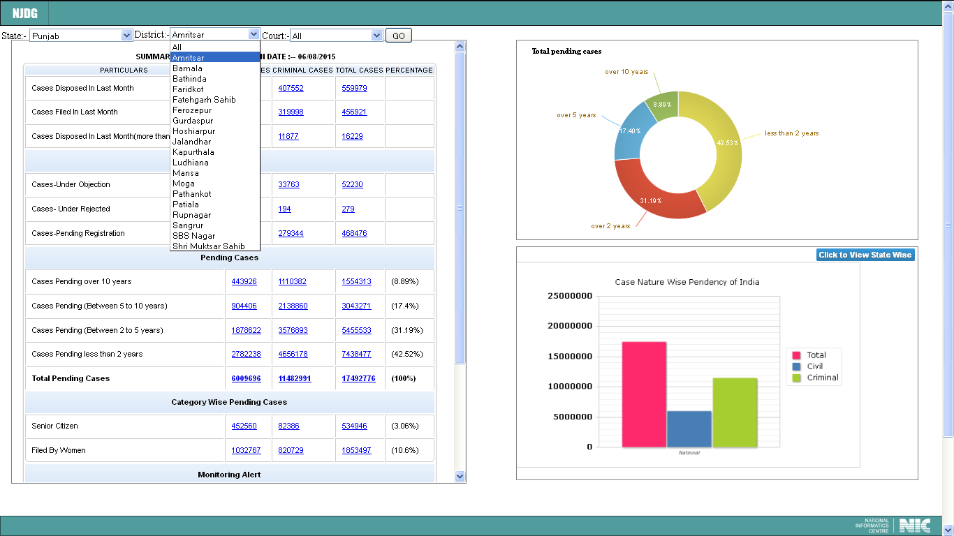
DISTRICT WISE DASH BOARD
Select District from drop down and click Go

Slide 63
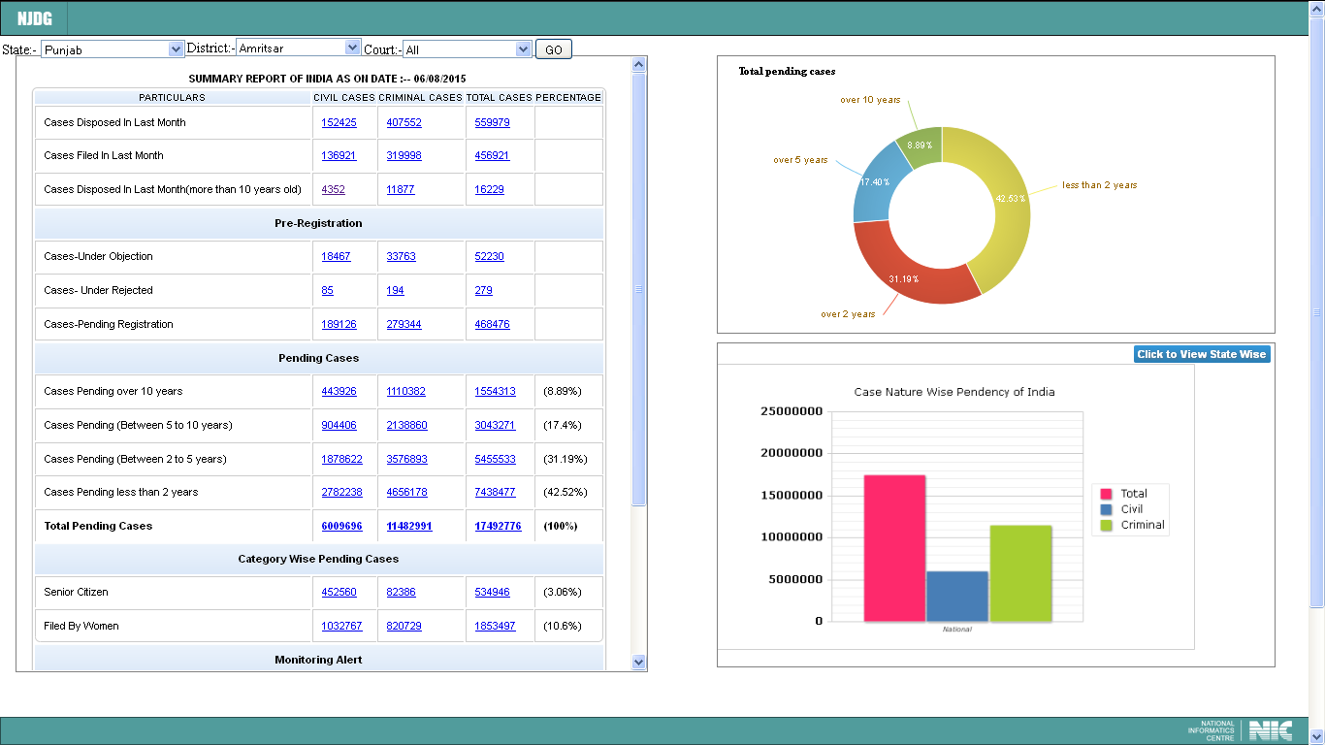
DISTRICT WISE DASH BOARD

Slide 64
DISTRICT WISE DASH BOARD

Slide 65
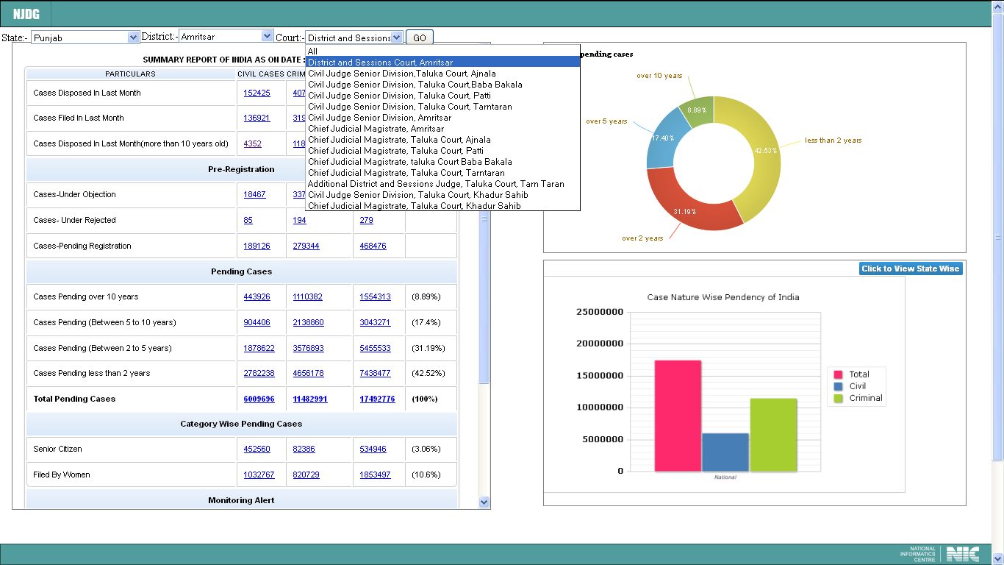
ESTABLISHMENT WISE DASH BOARD
Select Court
from drop down and click Go

Slide 66
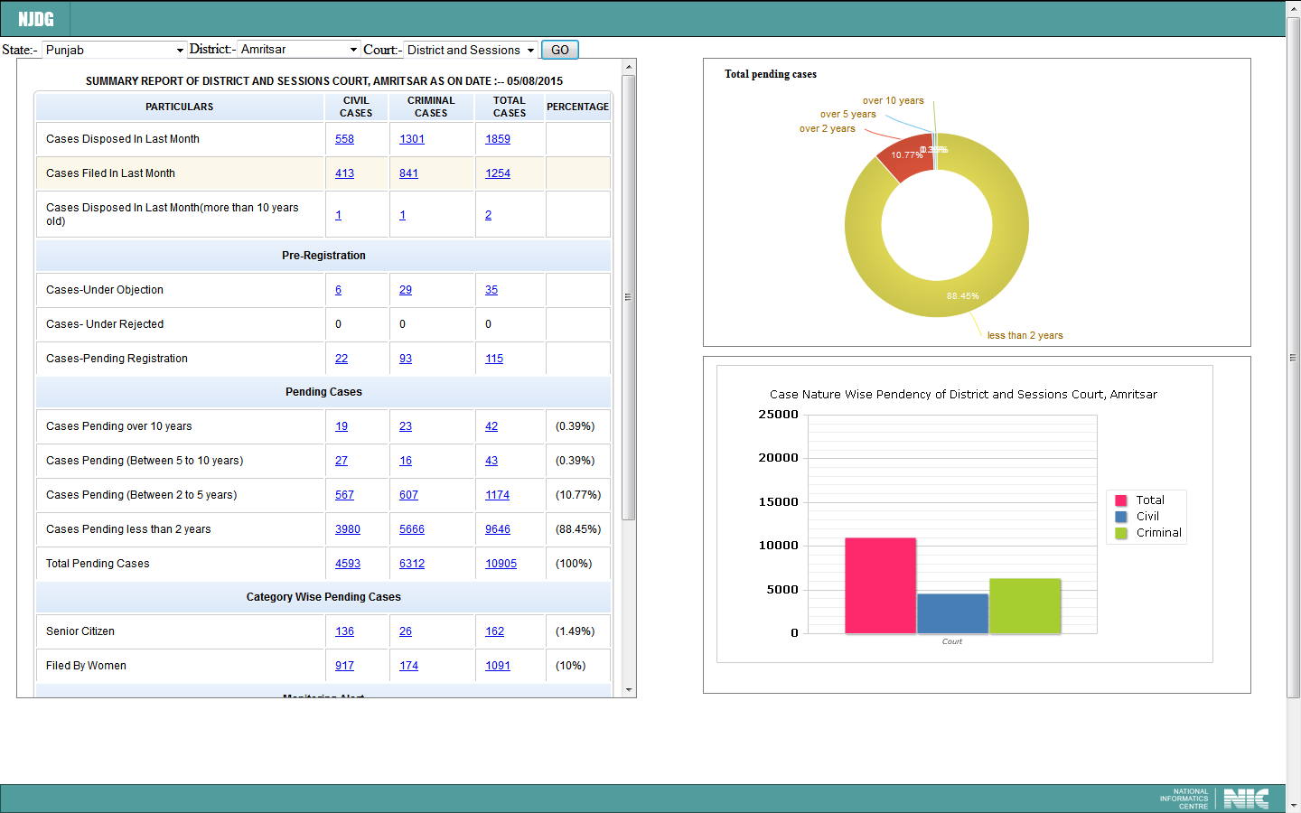
ESTABLISHMENT WISE DASH BOARD

Slide 67
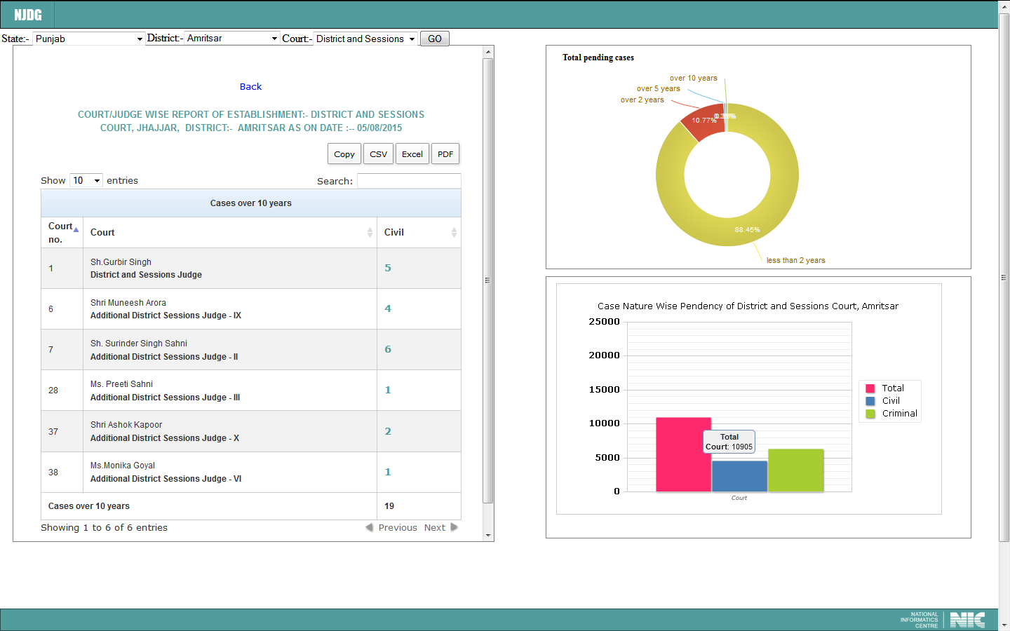
JUDGE/COURT WISE DASH BOARD
Click here to view these five cases.

Slide 68
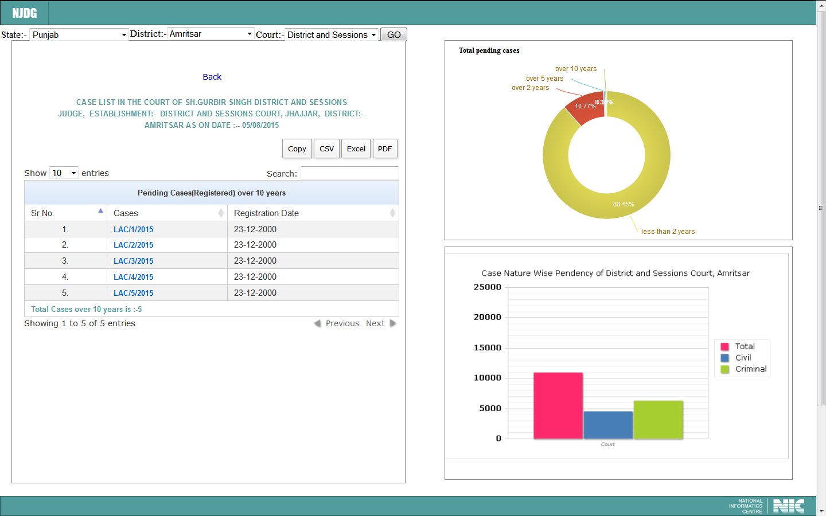

Slide 69
National Judicial Data Grid (NJDG)
Data uploading on the NJDG portal have to be further extended to all the Courts of the country and also to ensure regular data updation taking care of the connectivity issues. To achieve this and further improvising NJDG, a few of many enhancements to be taken in Phase II are as follows:

Slide 70
Provision of Date of uploading in the data being uploaded by the Court to facilitate reporting of chronological analysis of which Court Complex has uploaded data.
Automated triggers / alerts on dashboard for the Administrative Heads of the respective jurisdictions when the data uploading has been delayed beyond certain time limit e.g. two days or so.

Slide 71
All Periodical Returns of District Judiciary to be made available through NJDG data for High Courts.
NJDG to become communication pipeline for the purpose of judicial data transmission from lowest Court up to the Apex Court of the country so as to save on hundreds of man-hours invested for preparing statements on frequently sought information by superior Courts, Legislative Assemblies and Parliament.

Slide 72
Pendency / Arrears and Institution / Disposal Statements:
This will be based on the Act/Section, offences such as economic offences, offences against women, children, senior citizens etc.

Slide 73
Data mining
Data mining is the use of pattern recognition logic to identity trends within a sample data set and extrapolate this information against the larger data pool that is NJDG. Data mining discovers hidden patterns in data.

Slide 74
Data mining operates at a detail level instead of a summary level. Data mining process will assist in finding patterns in the given data set. These patterns can provide meaningful and insight trend analysis for the policy makers.
Data mining can also be used in a wide variety of contexts – in fraud detection, as an aid in litigation and adjudication trends, judicial Performance enhancement measures etc.

Slide 75
Online Analytical Processing (OLAP)
This tool will help efficiently querying multi-dimensional databases.
Whereas data mining techniques help analyzing hidden trends from the data, OLAP will help in the summing up of multiple databases into highly complex tables with summarized reports.

Slide 76
Business Intelligence (B. I.) Tools
The Data Mining and Online Analytcal Process (OLAP) being complementary to each other will form the engine for B. I. Tools which help in the most informative management information system for effective Court Management as Judicial Management Information.

Slide 77
The great end of all human industry is the attainment of happiness. For which
ARTS INVENTED,
SCIENCES CULTIVATED,
LAWS ORDAINED, &
SOCIETIES MODELLED

Slide 78
CONCLUSION
If there is no will to change,
no orientation
to the work culture
with technology,
then nothing can work.

Slide 79
Human knowledge arises only from sense experience.
The percepts and concepts actually present in the mind constitute the sole object of knowledge, with the objects of perception themselves, their origin outside the mind, or the nature of the mind itself remaining forever beyond inquiry.

Slide 80
Why we have to accept the change?
There is always
Evil against Good
. Wrong against Right .
.Injustice against Justice .
we always choose & select
GOOD and RIGHT thing to do JUSTICE
Because enemies of GOOD, RIGHT & JUSTICE are every where and we have to fight against them with the help of TECHNOLOGY because technology itself is the threat to the evil.

Slide 81
The Civilized Society,
The Government, The Legislature ,
The Judiciary
& The Media
have to perform their role,
each in their own areas of competence
and in a concerted manner for the process to be speedy and effective.

Slide 82
Thank you
Justice S G Shah
B. Sc. (Micro) LL. M.
Judge,
HIGH COURT OF GUJARAT
98250 49092
shahsg@msn.com

